Slide 1

Targeted Marketing for GetAllMart
Insights Squad : Sahar K, Nupur U, Rachana S, Hima S

Slide 2






Introduction to the Dataset
Customers
Demographics
Purchasing behavior
Promotions
Discount
Marketing Campaigns
Products
Wine
Fruits
Meat
Fish
Sweets
Gold products
Place
Websites
Catalogue
Stores
Web-visits
Notes:
Customes - demographics, purchasing behavior, and responses to marketing campaigns which makes up 22 attributes.
Purchases of different product categories such as wine, fruits, meat, fish, sweets, and gold products
Promotion number of purchases made with a discount, and whether the customer accepted the offer in the five marketing campaigns.
Finally, it includes the number of purchases made through the company's website, using a catalogue, and directly in stores, as well as the number of visits to the company's website in the last month.

Slide 3

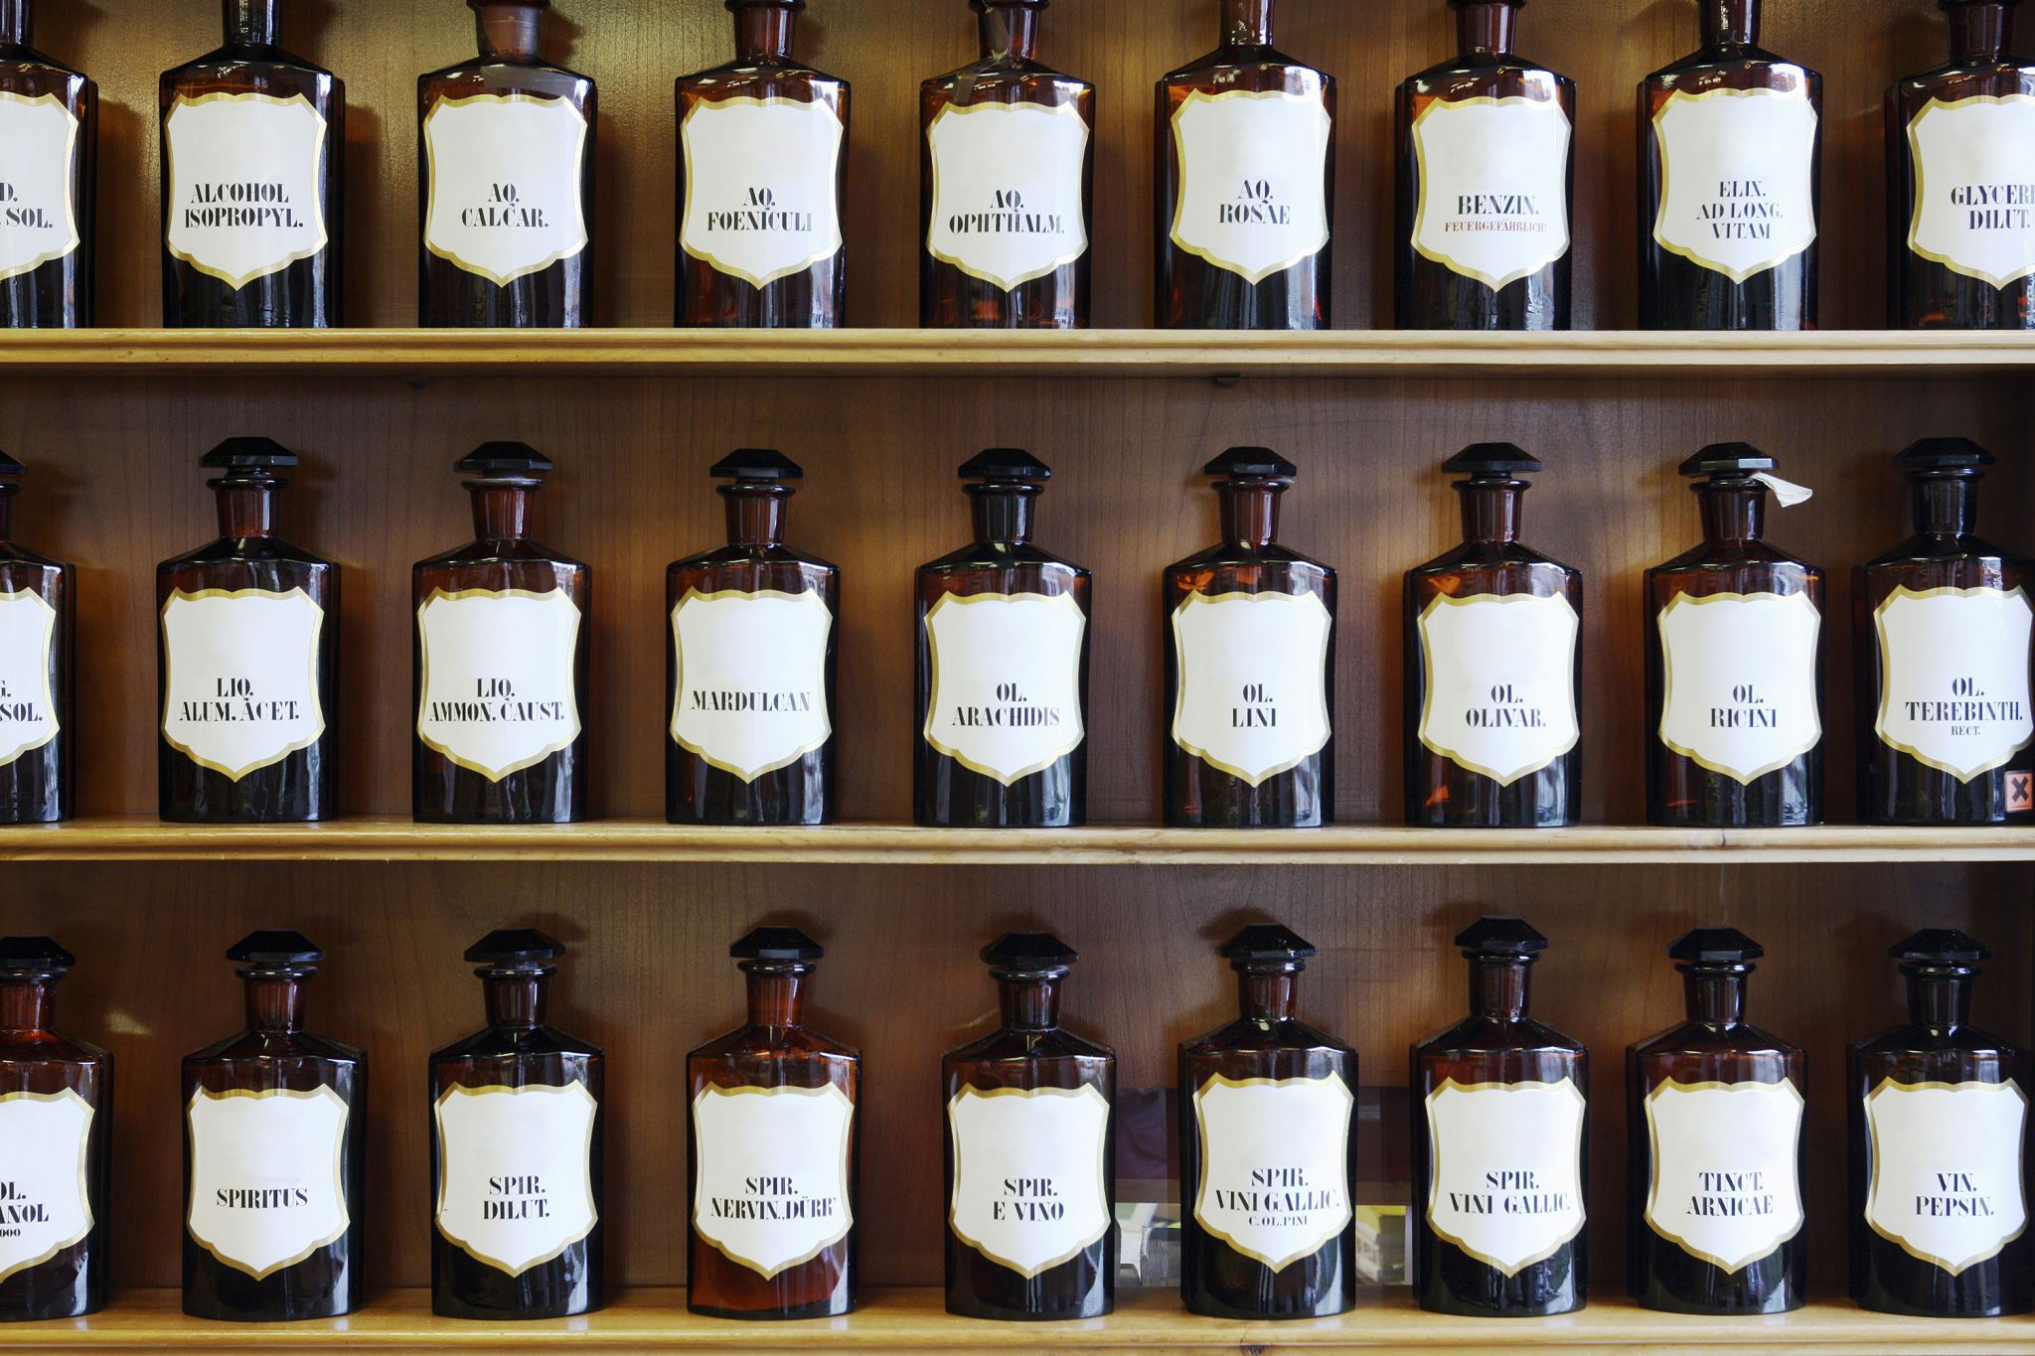
Objective
Analyze customer behavior and purchasing patterns
Understand the segments where current strategy is working
Diversify the market strategy to improve profitability
Provide actionable recommendations
Notes:
Provide actionable recommendations for increasing sales through a segmentation model
Analyze customer behavior and purchasing patterns to identify opportunities for higher campaign profits and target specific customer segments
Meet customers' needs, understand their product preferences, and identify areas where targeted campaigns can be more successful
Improve the company's market strategy by enhancing customer retention levels through increased customer satisfaction and loyalty while maximizing campaign profits

Slide 4

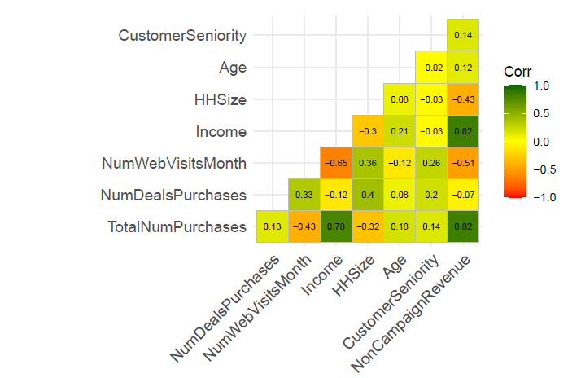
Findings from Exploratory Data Analysis
Weak positive correlation between Customer Seniority and Revenue
Lack of correlation between Age and Revenue
Negative correlation between Household Size and Non campaign Revenue
Notes:
Customer Seniority and Spend: Observed positive relation between customer seniority and total spend. However, we cannot make strong conclusions on this trend as the customer data was limited to 2 years
Ag
Age and Spend: Age did not seem to correlate strongly with either total purchases, total campaign and non-campaign spend
Household Size and Spend: Household Size seems to correlate negatively with non-campaign spend (refer Fig 1) indicating bigger households tend to shop less at “GetAllMart”.
Webvisits negative correlated to Income and also with deals but Purchase with income shows higher correlation. Can we say that people with purchasing power tend to care less about the deals and would look less often on websites for deals

Slide 5

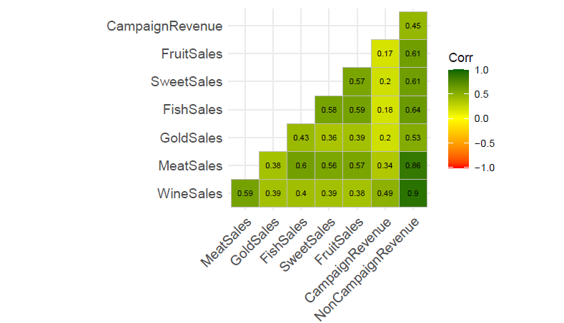
Findings from Exploratory Data Analysis Contd.
Campaign Performance indicative of spend in Wine & Meat categories
Non campaign performance largely positive with all product categories
Notes:
Campaign Performance and Products: Observed that customers who respond highly to campaigns tend to make purchases in Wine and Meat categories
Product and Spend: Spend patterns of “GetAllMart” indicate people across groups prefer to shop mainly Wine and Meat here

Slide 6
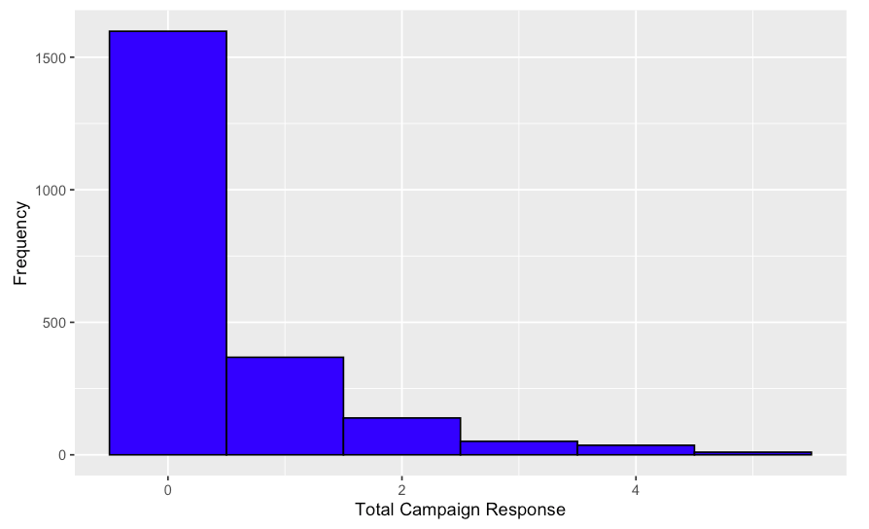
Campaign Response Trends
Notes:
6 camp, majority 0, some people 1 , more 2

Slide 7
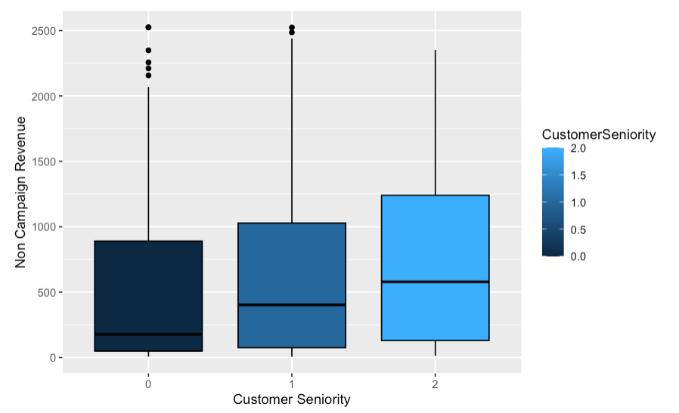
Customer Seniority

Slide 8

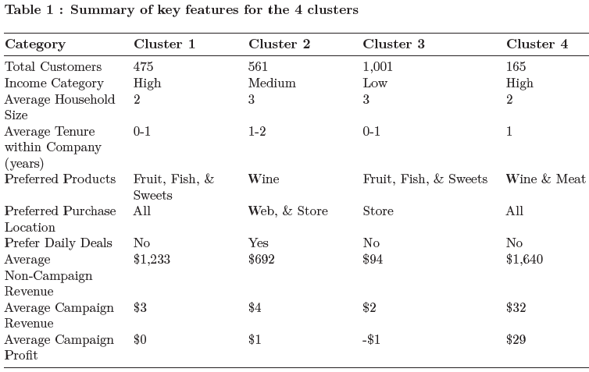
Findings from Cluster Analysis
Notes:
Cluster 1: Loyal Customers who do not respond well to campaigns nor store wide deals despite being active on all purchase platforms.
Cluster 2: Customers who respond highly to deals. However, when it comes to personalized campaigns, they have a moderate response as evidenced by the average revenue earned from each customer.
Cluster 3: Customers whose campaign and non-campaign spend patterns are lowest among all groups indicating the lack of purchasing power. They do not respond well to store wide deals nor campaigns. Infact the company is losing money by targeting this segment.
Cluster 4: Customers engaged the most with “GetAllMart” across product categories and are most profitable. They respond well to the personalized campaigns however they don’t seem to engage on store wide deals.

Slide 9

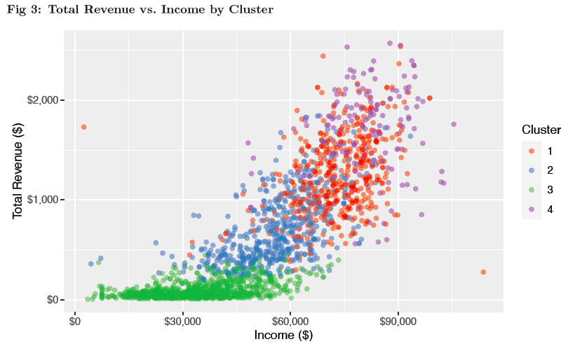
Relationship between Revenue and Income
Many customers have low spending and are concentrated below $30,000
Customers above $45,000 threshold indicate higher purchasing power with increase in Revenue
Notes:
Total Spend and Income: The analysis shows a fair amount of customer concentrated below $30,000 and display low spending. However above threshold of 45,000 customers purchasing power shows an increase with increase in Spend The scatter plot provides useful insights into the distribution of customers based on their income and spending levels, which can help the company make data-driven decisions about their marketing and pricing strategies

Slide 10

Recommendations for each cluster
Cluster 1
Cluster 2
Cluster 3
Cluster 4
Test a completely different offer focused on household groceries
Conduct A/B testing between the current offer and the new offer focused on household groceries
Stop targeting them for future campaigns or change the strategy by sending offers on household groceries
Maintain the current strategy
Notes:
For the first cluster, it is evident that the current marketing campaigns focused on Wine & Meat are not working. We recommend testing a completely different offer focused on daily groceries and assessing its performance to see if the response rate goes up.
For the second cluster, we suggest conducting A/B testing between the current offer focused on Wine & Meat and the new offer focused on fruit, fish, and sweets. Since this group belongs to medium income category and household size ~3 there is potential that they would respond well to offer focused on daily groceries. This will help evaluate if there is another promotion mix that will make them even more profitable
For the third customer cluster, we recommend not targeting them for future campaigns as our analysis shows that the cost of targeting this cluster is $3 while the profits are negative. However, if we do decide to target this cluster in future, we suggest sending offers on daily household groceries instead of pricier items such as wines as a household with kids/teens and lower income tends to look for offers in food category
For the fourth cluster, we believe our current marketing strategy is highly profitable and recommend keeping the same strategy for this cluster

Slide 11
Limitations
Exact offer details from previous campaigns are unknown
Customer data is limited to 2 years leading to difficulty in concrete conclusions
Lack of competitor information

Slide 12

Thank you

Slide 13
Appendix

Slide 14
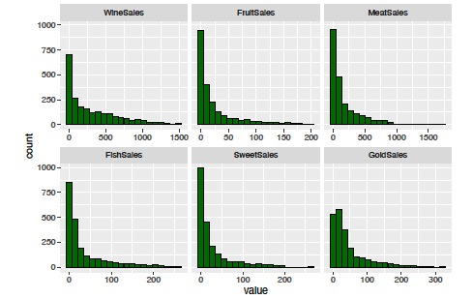
Product Sales

Slide 15
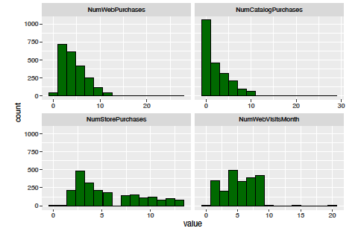
Purchase Location trends

Slide 16
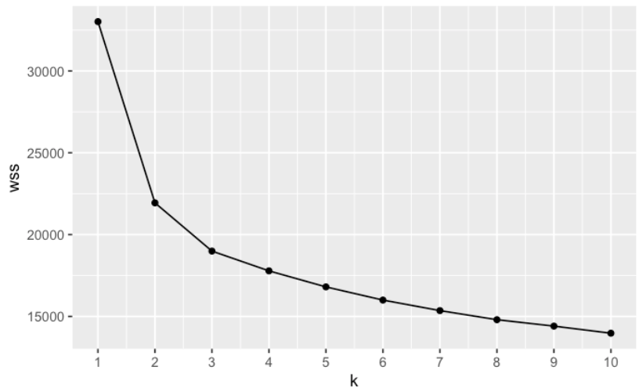
Scree Plot

Slide 17
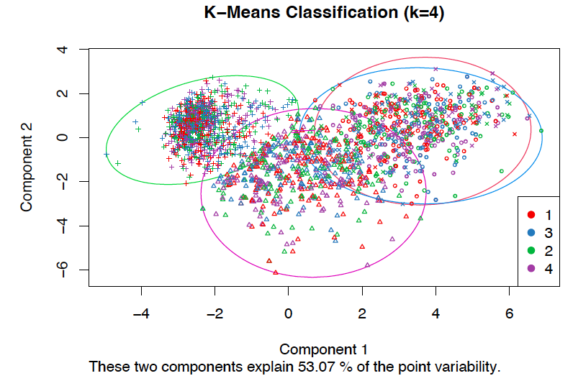
Cluster Plot

Slide 18
Disclaimer
Assumption:
Our marketing campaigns focuses on wines and meats, as indicated by past campaign performance
Modifications:
Calculated total product sales across all categories and campaign sales to understand customers’ total spending
Evaluated the impact of tenure of the customer with “GetAllMart” to distinguish between new and existing customers, determine loyalty, and understand purchase trends for targeted offers
Estimated Household Size by considering the Marital Status, number of kids & teens at home as marketing spends are usually dependent on the household demographics

